Slide 1
Chapter 5: EIGRPv6
Instructor Materials
CCNP Enterprise: Advanced Routing

Slide 2
Chapter 5 Content
This chapter covers the following content:
EIGRPv6 Fundamentals - This section provides an overview of EIGRPv6 and the correlation to EIGRP for routing IPv4 networks.
Troubleshooting EIGRPv6 Neighbor Issues - This section discusses the reasons EIGRPv6 neighbor relationships may not be formed and how to identify them.
Troubleshooting EIGRPv6 Routes - This section explores the reasons EIGRPv6 routes might be missing and how to determine why they are missing.
Troubleshooting Named EIGRP - This section introduces the show commands that you can use to troubleshoot named EIGRP configurations.
EIGRPv6 and Named EIGRP Trouble Tickets - This section provides trouble tickets that demonstrate how to use a structured troubleshooting process to solve a reported problem.

Slide 3
EIGRPv6 Fundamentals
EIGRP’s functional behavior is unchanged between IPv4 and IPv6.
The same administrative distance, metrics, timers, and DUAL mechanisms are in place to build the routing table.
This section is devoted to discussing the components of the routing protocol that are unique to IPv6.

Slide 4
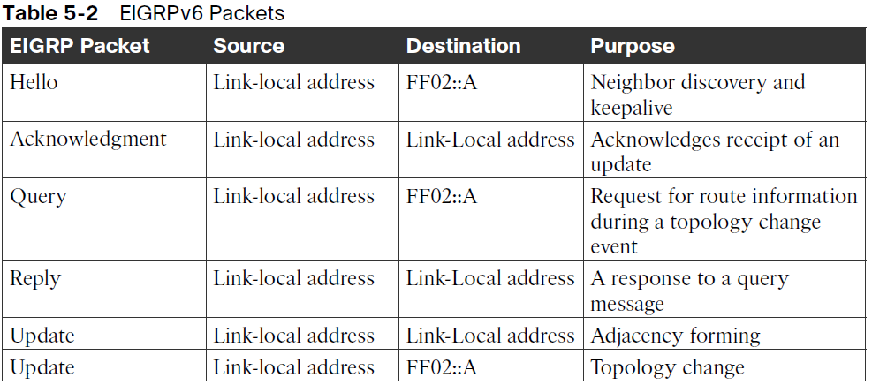
EIGRPv6 Fundamentals EIGRPv6 Inter-Router Communication
EIGRP packets are identified using the well-known protocol ID 88 for both IPv4 and IPv6.
When EIGRPv6 is enabled, the routers communicate with each other using the interface’s IPv6 link-local address as the source. The destination address may be either a unicast link-local address or the multicast link-local address FF02::A.
Table 5-2 shows the source and destination addresses for the EIGRP packet types.

Slide 5
EIGRPv6 Fundamentals EIGRPv6 Configuration
There are two methods for configuring IPv6 for EIGRP on IOS and IOS XE routers:
Classic AS mode
Named mode

Slide 6
EIGRPv6 Fundamentals EIGRPv6 Classic Mode Configuration
Classic mode is the original IOS method for enabling IPv6 on EIGRP. In this mode, the routing process is configured using an autonomous system number.
The steps for configuring EIGRPv6 on an IOS router are as follows:
Step 1. Configure the EIGRPv6 process by using the global configuration command ipv6 router eigrp as-number.
Step 2. Assign the router ID by using the IPv6 address family command eigrp router-id id. The router ID should be manually assigned to ensure proper operation of the routing process. The default behavior for EIGRP is to locally assign a router ID based on the highest IPv4 loopback address or, if that is not available, the highest IPv4 address.
Step 3. Enable the process on the interface by using the interface parameter command ipv6 eigrp as-number.

Slide 7
EIGRPv6 Fundamentals EIGRPv6 Named Mode Configuration
Named mode provides support for IPv4, IPv6, and virtual routing and forwarding (VRF), all within a single EIGRP instance.
The steps for configuring EIGRP named mode are as follows:
Step 1. Configure the EIGRPv6 routing process in global configuration mode by using the command router eigrp process-name. Unlike in classic mode, you specify a name instead of an autonomous system number.
Step 2. Define the address family and autonomous system number (ASN) to the routing process by using the command address-family ipv6 autonomous-system as-number.
Step 3. Assign the router ID by using the IPv6 address family command eigrp router-id router-id.
All of the EIGRP-specific interface parameters are configured in the af-interface default or af-interface interface-id submode within the IPv6 address family of the named EIGRP process.
When the IPv6 address family is configured for the EIGRP named process, all the IPv6-enabled interfaces immediately start participating in routing. To disable the routing process on the interface, the interface needs to be shut down in af-interface configuration mode.

Slide 8
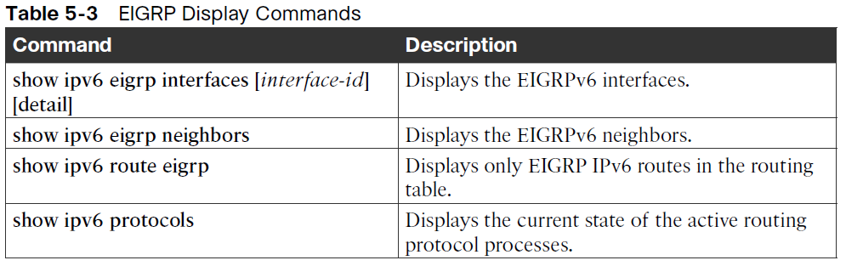
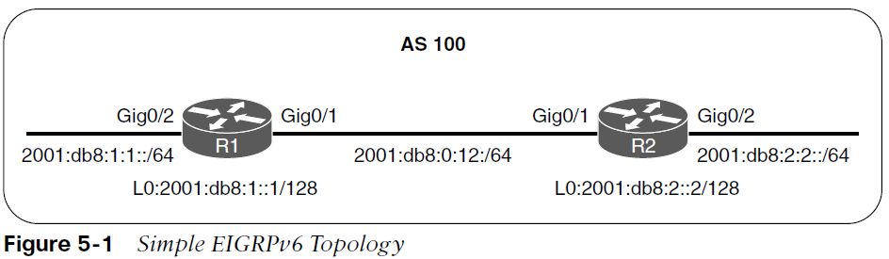
EIGRPv6 Fundamentals EIGRPv6 Verification
IPv6 uses the same EIGRP verification commands described in Chapters 3 and 4. Table 5-3 lists the IPv6 versions of the show commands that are covered in this chapter.

Slide 9
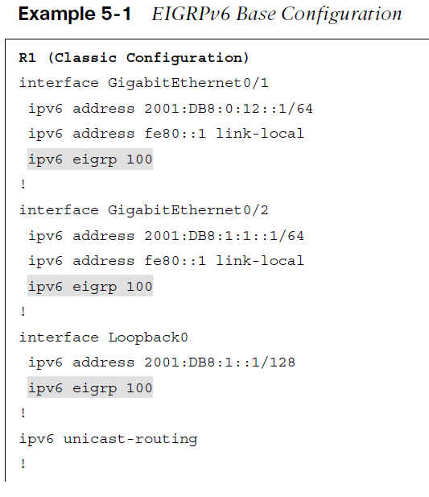
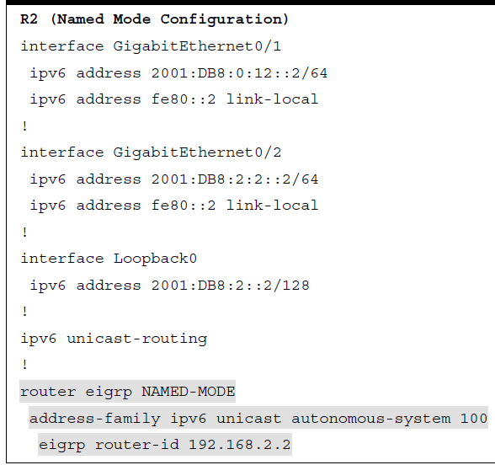
EIGRPv6 Fundamentals EIGRPv6 Verification Configuration
Example 5-1 shows the full EIGRPv6 configuration for the sample topology. Both EIGRPv6 classic AS and named mode configurations are provided.

Slide 10
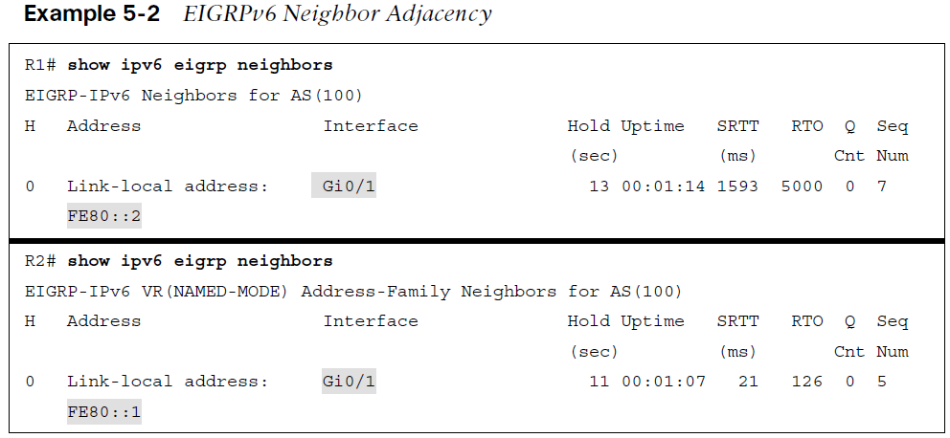
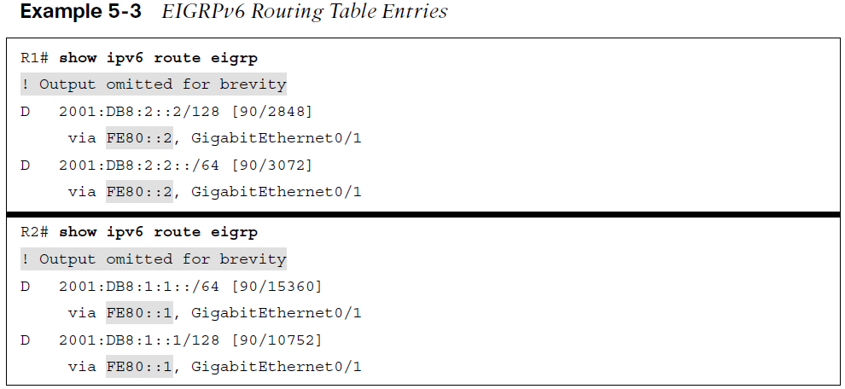
EIGRPv6 Fundamentals EIGRPv6 Verification Configuration
Example 5-2 provides verification of the EIGRPv6 neighbor adjacency. Example 5-3 shows routing table entries for R1 and R2.

Slide 11
EIGRPv6 Fundamentals IPv6 Route Summarization
There is no concept of classful or classless routing in IPv6, and therefore, autosummarization is not possible. EIGRPv6 summarization for IPv6 is manually configured on a per-interface basis, using the same rules as for IPv4:
The summary aggregate prefix is not advertised until a prefix matches it.
More specific prefixes are suppressed.
A Null0 route with an administrative distance of 5 is added to the routing table as a loop-prevention mechanism.
A leak map can be used to advertise more specific prefixes while advertising a summary address.
Network summarization is configured at the interface level in classic mode using the command ipv6 summary-address eigrp as-number ipv6-prefix/prefix-length or in named mode with the command summary-address ipv6-prefix/prefix-length under af-interface.

Slide 12
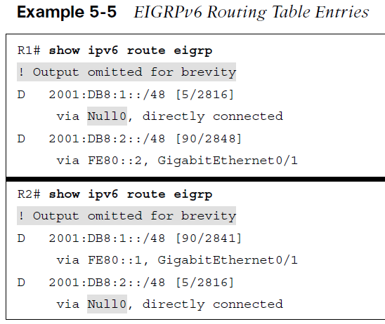
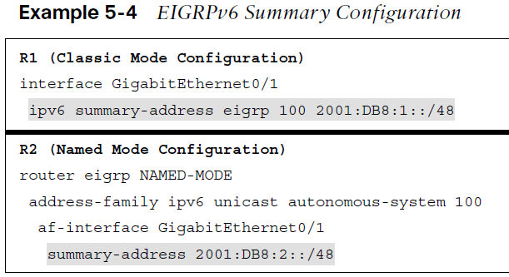
EIGRPv6 Fundamentals IPv6 Route Summarization
Example 5-4 demonstrates how to configure R1 to advertise a 2001:db8:1::/48 summary route to R2 and how to configure R2 to advertise a 2001:DB8:2::/48 summary route to R1.
Example 5-5 shows the routing tables for R1 and R2. Notice that only the /48 summary prefix is received from the neighbor router and that the more specific /64 and /128 route entries are suppressed. A Null0 route is populated on the router for the local /48 summary route advertisement.

Slide 13
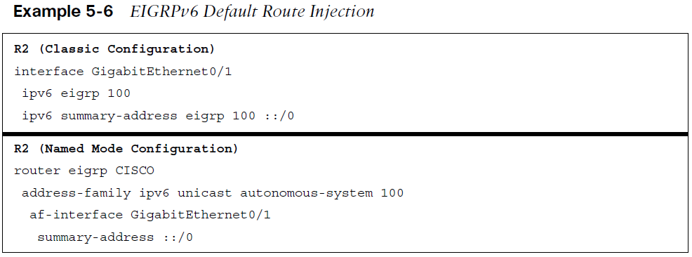
EIGRPv6 Fundamentals Default Route Advertising
Advertise a default route into the EIGRPv6 topology by placing the default prefix (::/0) as a summary address at the interface level. When you use the summary method, all prefix advertisements are suppressed by the router, except for the ::/0 default route entry.
Example 5-6 demonstrates the two configuration methods for injecting a default route into EIGRPv6.

Slide 14
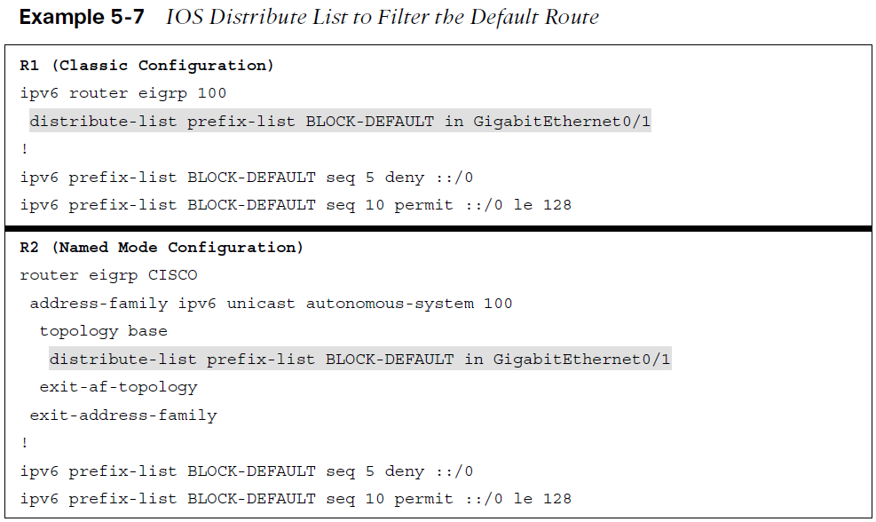
EIGRPv6 Fundamentals Route Filtering
In IOS and IOS XE, use prefix lists to match IPv6 routes in route maps and distribution lists.
Example 5-7 demonstrates how to use a distribution list for filtering the default route ::/0 advertisements from an upstream neighbor connected to interface GigabitEthernet0/1.
The associated prefix list BLOCK-DEFAULT with sequence 5 is a deny statement that filters the exact match for the default route prefix ::/0. Sequence 10 is a permit-any match statement that allows a prefix of any length to be received.

Slide 15
Troubleshooting EIGRPv6 Neighbor Issues
EIGRPv6 is based on EIGRP for IPv4, it involves similar issues when it comes to troubleshooting, although there are a few differences for IPv6.
Although you do not have to learn a large amount of new information for EIGRPv6, you do need to know the show commands that will display the information you need to troubleshoot any given EIGRPv6-related issue.

Slide 16
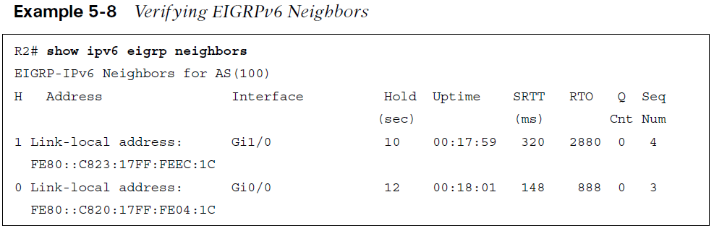
Troubleshooting EIGRPv6 Neighbor Issues Neighbor Issues
The neighbor issues are mostly the same, except for a few differences based on the way EIGRPv6 is enabled on an interface.
To verify EIGRPv6 neighbors, use the show ipv6 eigrp neighbors command, as shown in Example 5-8. Notice how EIGRPv6 neighbors are identified by their link-local address. In this case, R2 is a neighbor of two different routers. One is reachable out Gi1/0, and the other is reachable out Gi0/0.

Slide 17
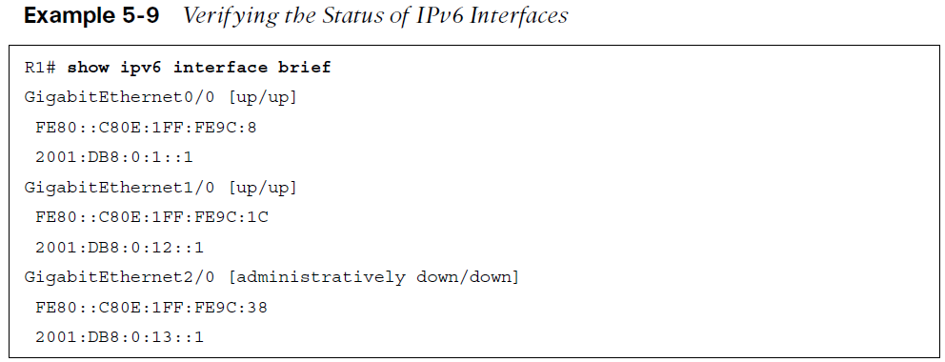
Troubleshooting EIGRPv6 Neighbor Issues Interface Is Down
Verify that an interface is up, you use the show ipv6 interface brief command, as shown in Example 5-9.
In this example, GigabitEthernet0/0 and GigabitEthernet1/0 are up/up, and GigabitEthernet2/0 is administratively down/down. This indicates that GigabitEthernet2/0 has been configured with the shutdown command.

Slide 18
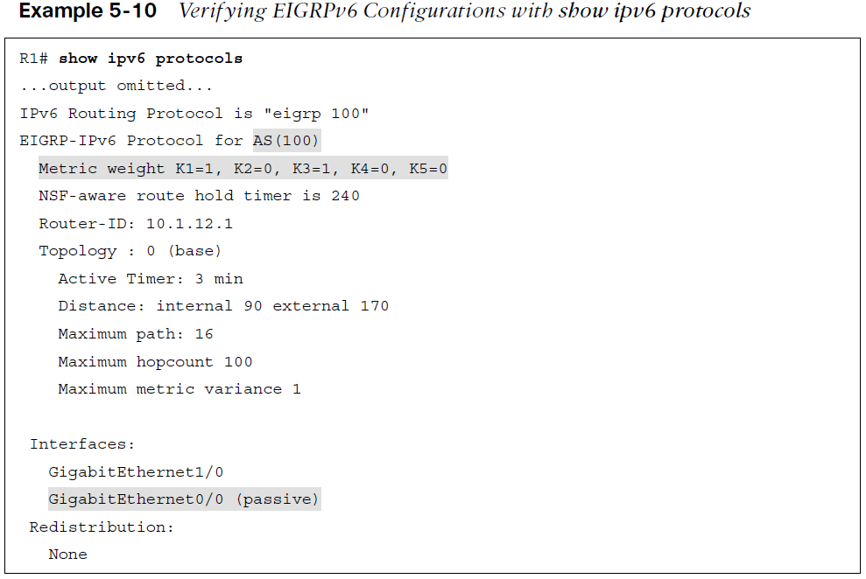
Troubleshooting EIGRPv6 Neighbor Issues EIGRP Issues
Mismatched Autonomous System Numbers: To verify the autonomous system number being used, you can use the show ipv6 protocols command, as shown in Example 5-10. In this example, the EIGRP autonomous system is 100.
Mismatched K Values: You verify the EIGRPv6 K values with the command show ipv6 protocols, as shown in Example 5-10. In this example, the K values are 1, 0, 1, 0, and 0, which are the defaults.
Passive Interfaces: To verify the router interfaces participating in the EIGRPv6 autonomous system that are passive, you use the show ipv6 protocols command, as shown in Example 5-10. In this example, GigabitEthernet 0/0 is a passive interface.

Slide 19
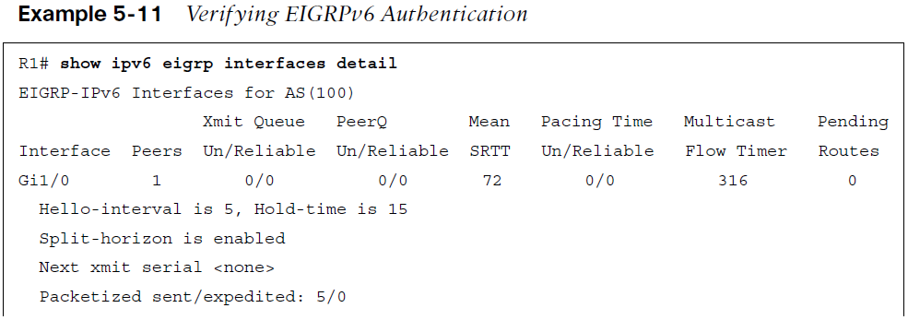
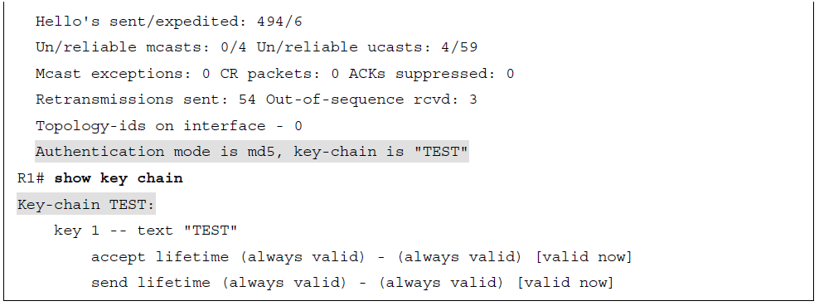
Troubleshooting EIGRPv6 Neighbor Issues Mismatched Authentication
Authentication: The key ID and key string must match, and if the valid times are configured they must match as well between neighbors.
Example 5-11 shows how to verify whether an interface is enabled for EIGRPv6 authentication with the show ipv6 eigrp interfaces detail command and how to verify the configuration of the keychain that is being used with the show key chain command. In this example, the authentication mode is MD5, and the keychain TEST is being used.
Timers: They do not have to match; however, if they are not configured appropriately, neighbor relationships might flap. Verify timers with the show ipv6 eigrp interfaces detail command.

Slide 20
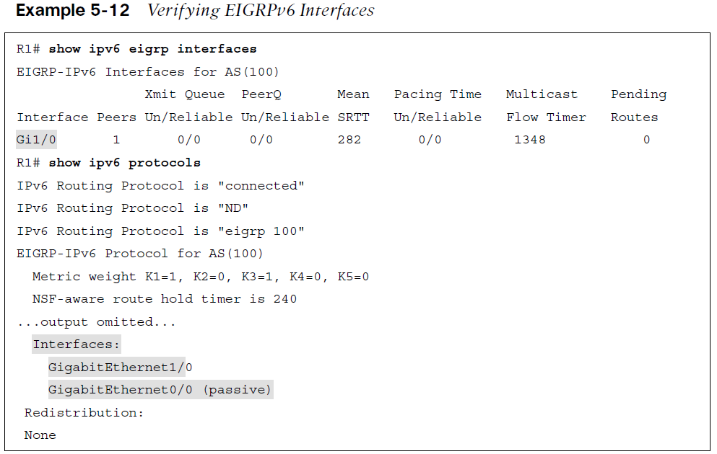
Troubleshooting EIGRPv6 Neighbor Issues Interface Not Participating in Routing Process
With EIGRPv6, the interfaces are enabled for the routing process with the ipv6 eigrp autonomous_system_number interface configuration command.
You can use two show commands, show ipv6 eigrp interfaces and show ipv6 protocols, to verify the interfaces that are participating in the routing process, as shown in Example 5-12.

Slide 21
Troubleshooting EIGRPv6 Neighbor Issues ACLs
ACLs: EIGRPv6 uses the IPv6 multicast address FF02::A to form neighbor adjacencies.
If an IPv6 access control list (ACL) is denying packets destined to the multicast address FF02::A, neighbor adjacencies do not form.
In addition, because neighbor adjacencies are formed with link-local addresses, if the link-local address range is denied based on the source or destination IPv6 address in an interface with an IPv6 ACL, neighbor relationships do not form.

Slide 22
Troubleshooting EIGRPv6 Routes
The reasons a route might be missing and the steps used to troubleshoot them with EIGRPv6 are similar to those listed in Chapter 4 for EIGRP for IPv4.
This section identifies some of the most common issues and the show commands you should use to detect them.

Slide 23
Troubleshooting EIGRPv6 Routes Interface Not Participating in the Routing Process
For a network to be advertised by the EIGRPv6 process, the interface associated with that network must be participating in the routing process.
As shown in Example 5-12, you can use the commands show ipv6 eigrp interfaces and show ipv6 protocols to verify the interfaces participating in the process.

Slide 24
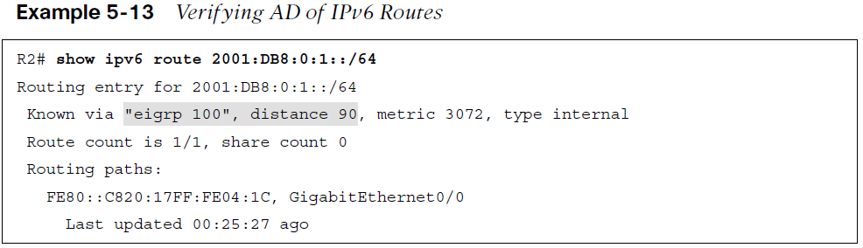
Troubleshooting EIGRPv6 Routes Better Source of Information
If exactly the same network is learned from a more reliable source, it is used instead of the EIGRPv6-learned information.
To verify the AD associated with the route in the routing table, you can issue the show ipv6 route ipv6_address/prefix command. In Example 5-13, the 2001:db8:0:1::/64 network has an AD of 90, and it was learned from EIGRP autonomous system 100.

Slide 25
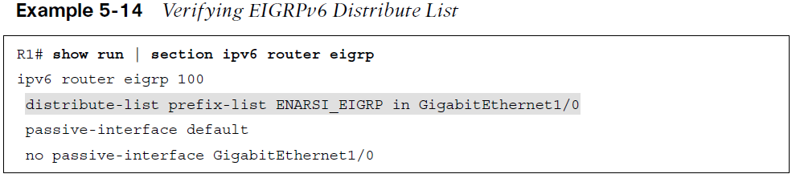
Troubleshooting EIGRPv6 Routes Route Filtering
A filter might be preventing a route from being advertised or learned. With EIGRPv6, the distribute-list prefix-list command is used to configure a route filter. To verify the filter applied, use the show run | section ipv6 router eigrp command.
In Example 5-14, a distribute list is using a prefix list called ENARSI_EIGRP to filter routes inbound on GigabitEthernet1/0.
To successfully troubleshoot route filtering issues, you also need to verify the IPv6 prefix list by using the show ipv6 prefix-list command.

Slide 26
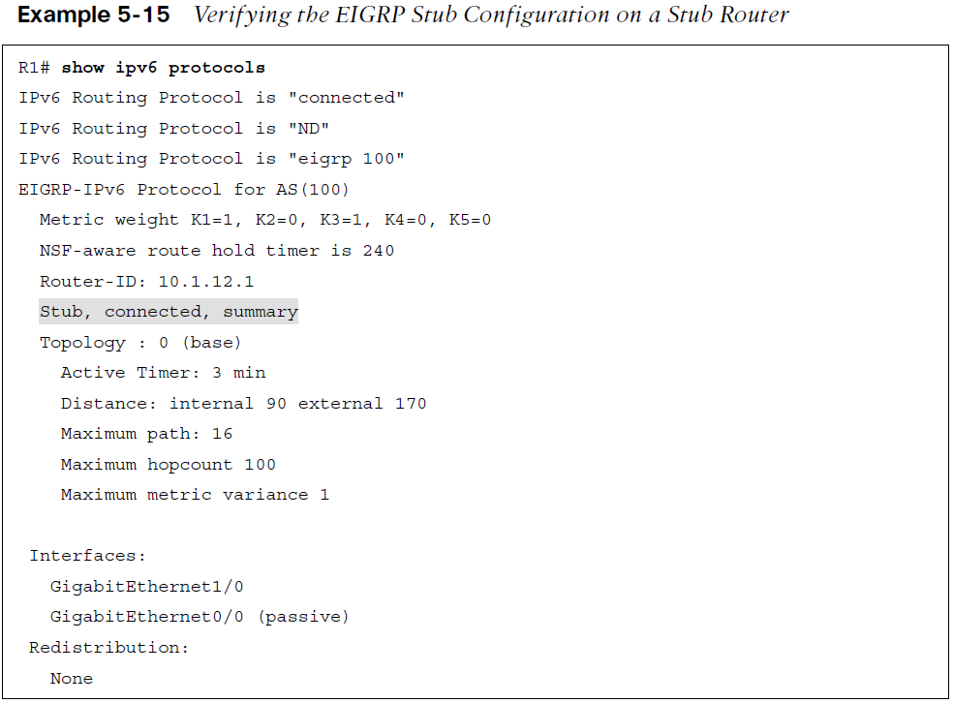
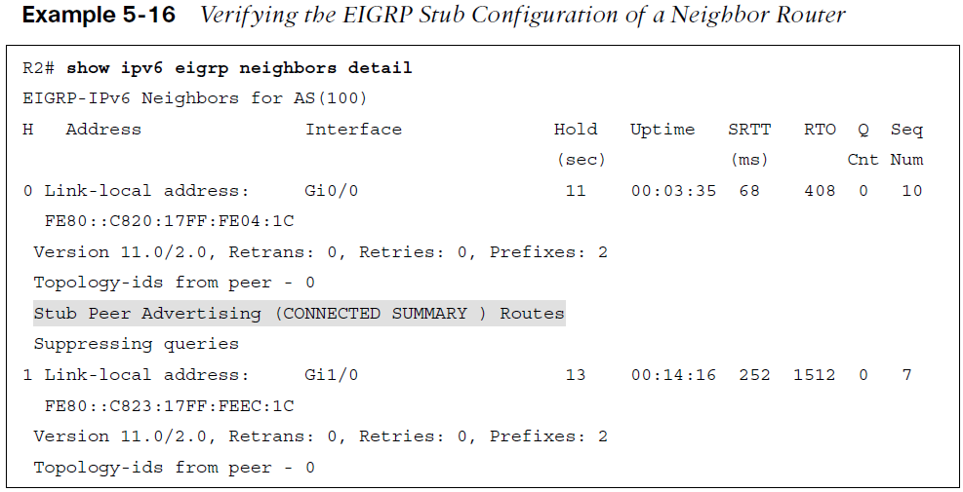
Troubleshooting EIGRPv6 Routes Stub Configuration
If the wrong router is configured as a stub router, or if the wrong setting is chosen during stub router configuration, it might prevent a network from being advertised when it should be advertised. In this case, R1 is a stub router advertising connected and summary routes.

Slide 27
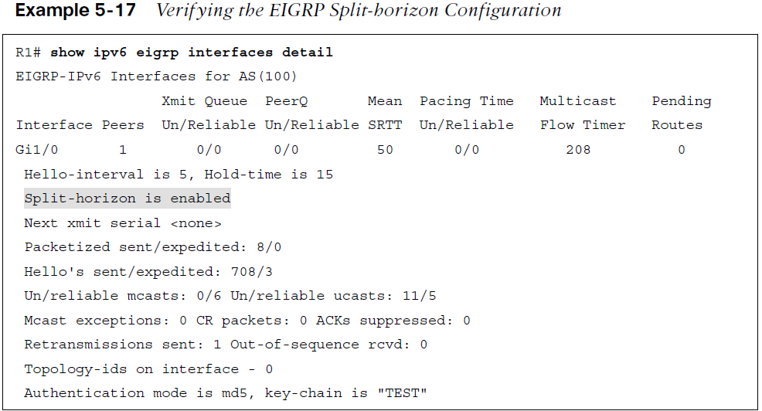
Troubleshooting EIGRPv6 Routes Split Horizon
Split horizon is a loop-prevention feature that prevents a router from advertising routes out the same interface on which they were learned.
As shown in Example 5-17, you can verify whether split horizon is enabled or disabled by using the show ipv6 eigrp interfaces detail command.
Split horizon is an issue in EIGRPv6 network designs that need routes to be advertised out interfaces on which they were learned—either a nonbroadcast multi-access (NBMA) Frame Relay hub-and-spoke topology or a Dynamic Multipoint Virtual Private Network (DMVPN) network which both use multipoint interfaces on the hub. Split horizon needs to be disabled on the hub in these networks.

Slide 28
Troubleshooting Named EIGRP
Named EIGRPv6 has some differences in the configuration, however all the issues already discussed for EIGRP for IPv4 and EIGRPv6 apply here as well.
This section covers the show commands that you can use to troubleshoot named EIGRP configurations.

Slide 29
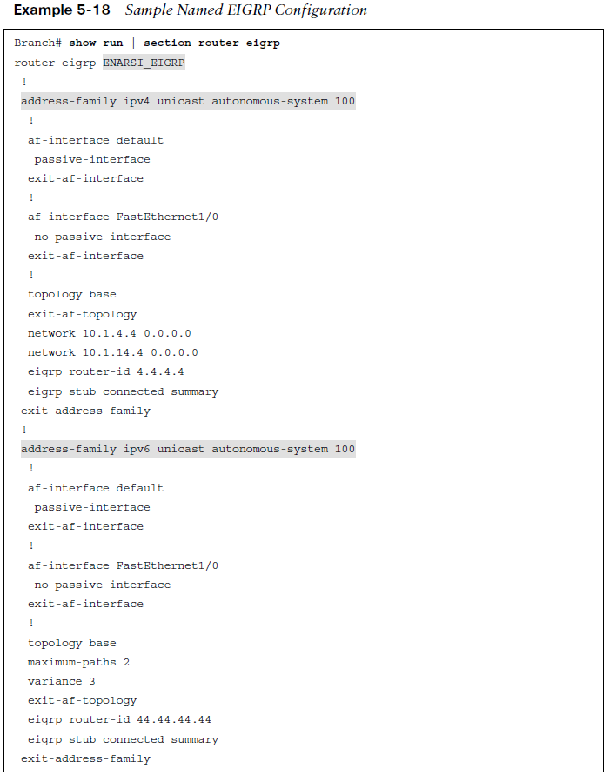
Troubleshooting Named EIGRP Sample Named EIGRP Configuration
The purpose of EIGRP named configuration is to provide a central location on the local router to perform all EIGRP for IPv4 and IPv6 configuration.
Example 5-18 provides a sample named EIGRP configuration called ENARSI_EIGRP.
This named EIGRP configuration includes an IPv4 unicast address family and an IPv6 unicast address family.
They are both using autonomous system 100; however, that is not mandatory and does not cause conflict as these are separate routing processes.

Slide 30
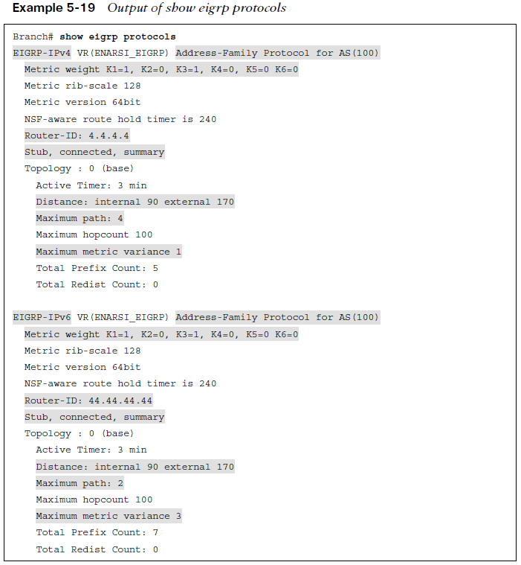
Troubleshooting Named EIGRP Named EIGRP Show Commands
With named EIGRP, you can use all the same EIGRP show commands. However, there is also a new set of show commands for named EIGRP.
The command show eigrp protocols (see Example 5-19) shows both the EIGRP for IPv4 address family and the EIGRPv6 address family, along with:
autonomous system number
K values
router ID
whether the router is a stub router
the AD
the maximum paths
the variance

Slide 31
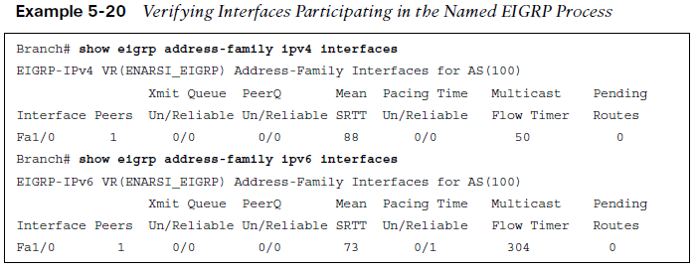
Troubleshooting Named EIGRP Named EIGRP: Verify Interfaces
To verify the interfaces that are participating in the routing process for each address family, you can issue the show eigrp address-family ipv4 interfaces command and the show eigrp address-family ipv6 interfaces command, as shown in Example 5-20.
Note that passive interfaces do not show up in this output. Use the classis show ip protocols and show ipv6 protocols commands to verify passive interfaces

Slide 32
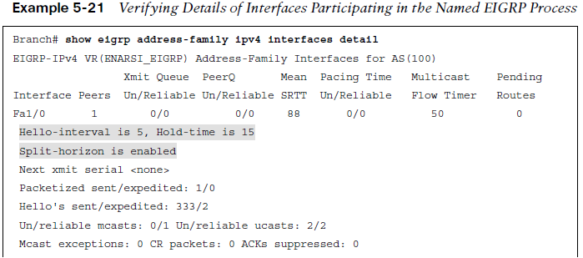
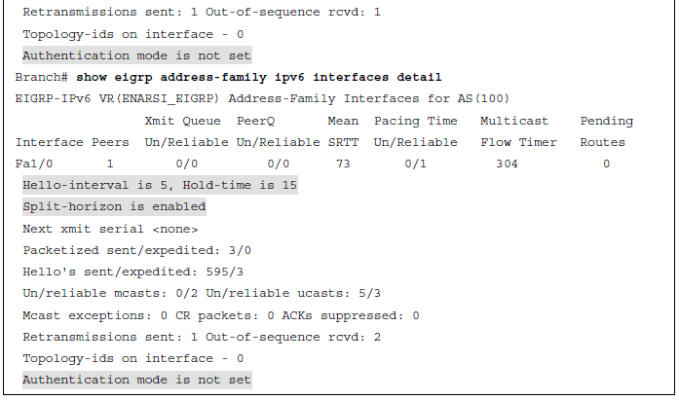
Troubleshooting Named EIGRP Named Interface Verify Details
As shown in Example 5-21, when you add the detail keyword to the show eigrp address-family ipv4 interfaces command and the show eigrp address-family ipv6 interfaces command.
You can verify additional interface parameters (for example, hello interval and hold time, whether split horizon is enabled, whether authentication is set, and statistics about hellos and packets).

Slide 33
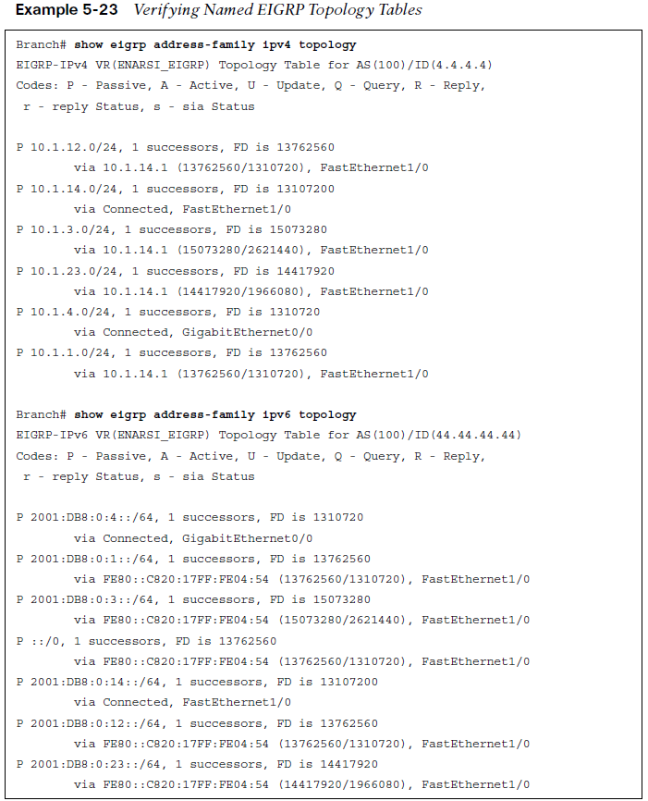
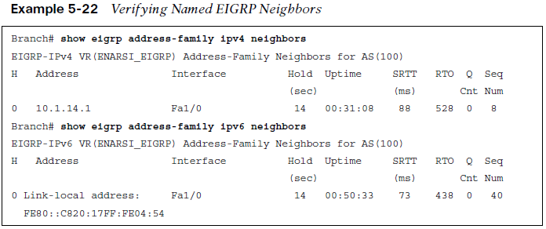
Troubleshooting Named EIGRP Verify Named EIGRP Neighbors
You can verify neighbors with the show eigrp address-family ipv4 neighbors and show eigrp address-family ipv6 neighbors commands, as shown in Example 5-22.
To display the topology table, you can use the commands show eigrp address-family ipv4 topology and show eigrp address-family ipv6 topology, as shown in Example 5-23.

Slide 34
EIGRPv6 and Named EIGRP Trouble Tickets
This section presents various trouble tickets related to the topics discussed earlier in this chapter.
These trouble tickets show a process that you can follow when troubleshooting in the real world or in an exam environment.

Slide 35
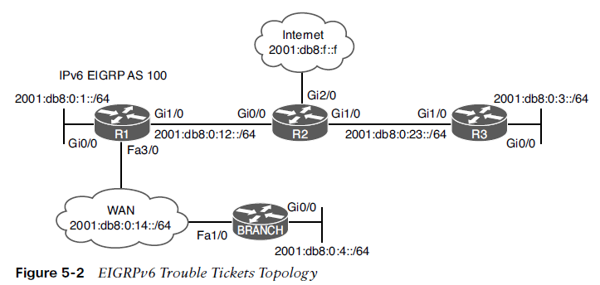
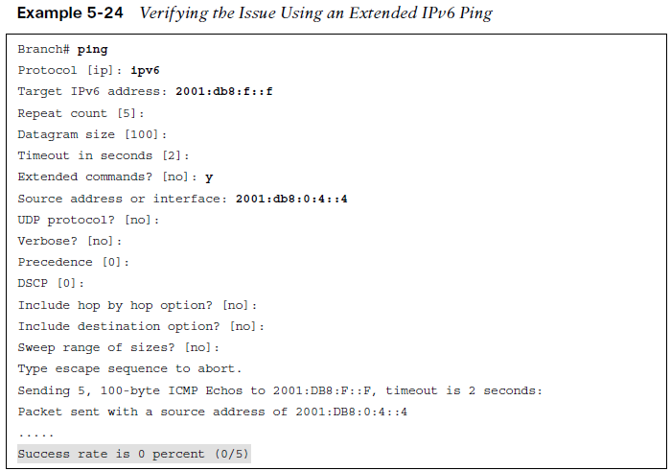
EIGRPv6 and Named EIGRP Trouble Tickets Trouble Ticket 5-1
Trouble Ticket 5-1 is based on the topology shown in Figure 5-2.
Problem: Users in the Branch network 2001:db8:0:4::/64 have indicated that they are not able to access the Internet.
To verify the problem, you ping 2001:db8:f::f with the source address 2001:db8:0:4::4, as shown in Example 5-24. The ping fails.
Refer to your text for next steps and examples to troubleshoot and resolve this trouble ticket.

Slide 36
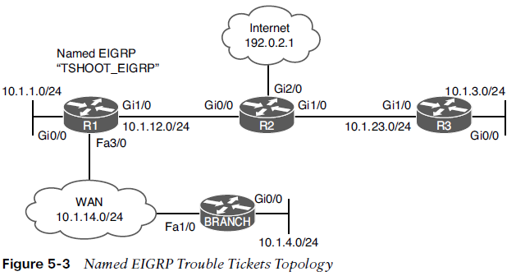
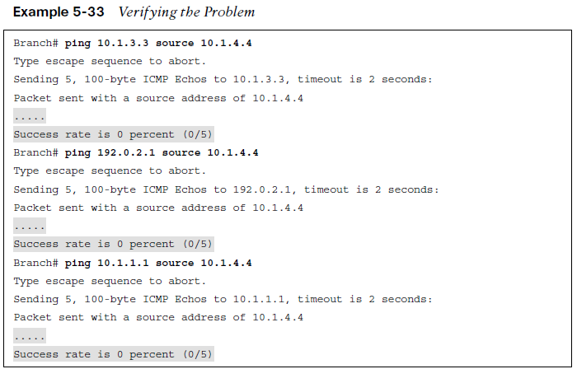
EIGRPv6 and Named EIGRP Trouble Tickets Trouble Ticket 5-2
Trouble Ticket 5-2 is based on the topology shown in Figure 5-3.
Problem: Users in the 10.1.4.0/24 network indicate that they are not able to access resources outside their LAN.
On Branch, you verify the problem by pinging a few different IP addresses and source the packets from 10.1.4.4. As shown in Example 5-33, they all fail.
Refer to your text for next steps and examples to troubleshoot and resolve this trouble ticket.

Slide 37
Prepare for the Exam

Slide 38
Prepare for the Exam Key Topics for Chapter 5
Description
EIGRPv6 Packets | Troubleshooting EIGRPv6 Neighbor Issues
EIGRPv6 classic configuration | Two key addresses to considered when troubleshooting ACLs and EIGRPv6 neighborships
EIGRPv6 named mode configuration | Administrative distance and the effects it has on populating the routing table with EIGRPv6 routes
Disabling the routing process on an interface | Route filtering and the effects it has on populating the routing table with EIGRPv6 routes
EIGRPv6 route summarization | Output of show eigrp protocols
EIGRPv6 route summarization | Verifying Details of Interfaces Participating in the Named EIGRP Process
Route Filtering | Verifying Named EIGRP Neighbors

Slide 39
Prepare for the Exam Key Topics for Chapter 5
Description
hello packet | split horizon
FF02::A | successor
network command | feasible successor
autonomous system number | reported distance
K value | feasible distance
passive interface | maximum paths
key ID | variance
key string | named EIGRP
keychain | address family
stub

Slide 40
Prepare for the Exam Command Reference Chapter 5
Task | Command Syntax
Initialize EIGRPv6 with classic configuration | ipv6 router eigrp as-number eigrp router-id id interface interface-id ipv6 eigrp as-number
Initialize EIGRPv6 with named mode configuration | router eigrp process-name address-family ipv6 autonomous-system as-number eigrp router-id id
Display all EIGRPv6 interfaces | show ipv6 eigrp interface [interface-id] [detail]
Display established EIGRPv6 neighbors | show ipv6 eigrp neighbors
Show a router’s EIGRPv6 neighbors | show ipv6 eigrp neighbors

Slide 41
Prepare for the Exam Command Reference Chapter 5 (Cont.)
Task | Command Syntax
Display the IPv6 routing protocols enabled on the router | show ipv6 protocols
Display all of a router’s interfaces that are configured to participate in an EIGRPv6 routing process (with the exception of passive interfaces) | show ipv6 eigrp interfaces
Display the interfaces participating in the EIGRPv6 routing process, along with EIGRP hello and hold timers, whether the split horizon rule is enabled, and whether authentication is being used | show ipv6 eigrp interfaces detail
Display the IPv6 EIGRP configuration in the running configuration | show run | section ipv6 router eigrp

Slide 42
Prepare for the Exam Command Reference Chapter 5 (Cont.)
Task | Command Syntax
Show detailed information about a router’s EIGRP neighbors, including whether the neighbor is a stub router, along with the types of networks it is advertising as a stub | show ipv6 eigrp neighbors detail
Show routes known to a router’s IP routing table that were injected by the router’s EIGRP routing process | show ipv6 route eigrp
Display detailed information about the EIGRP for IPv4 and IPv6 address families that are enabled on the router. | show eigrp protocols
Display the interfaces that are participating in the named EIGRP for IPv4 address family | show eigrp address-family ipv4 interfaces
Display the interfaces that are participating in the named EIGRPv6 address family | show eigrp address-family ipv6 interfaces

Slide 43
Prepare for the Exam Command Reference Chapter 5 (Cont.)
Task | Command Syntax
Display detailed information about the interfaces participating in the named EIGRP for IPv4 address family, including hello interval and hold time, whether split horizon is enabled, if authentication is set, and statistics about hellos and packets | show eigrp address-family ipv4 interfaces detail
Display detailed information about the interfaces participating in the named EIGRPv6 address family, including hello interval and hold time, whether split horizon is enabled, if authentication is set, and statistics about hellos and packets | show eigrp address-family ipv6 interfaces detail
Display the EIGRP for IPv4 neighbor relationships that have formed | show eigrp address-family ipv4 neighbors
Display the EIGRPv6 neighbor relationships that have formed | show eigrp address-family ipv6 neighbors

Slide 44
Prepare for the Exam Command Reference Chapter 5 (Cont.)
Task | Command Syntax
Display the EIGRP for IPv4 topology table for the address family | show eigrp address-family ipv4 topology
Display the EIGRPv6 topology table for the address family | show eigrp address-family ipv6 topology
Display all EIGRP packets exchanged with a router’s EIGRP neighbors; however, the focus of the command can be narrowed to display only specific EIGRP packet types (for example, EIGRP hello packets) | debug eigrp packets

